Slide 1
Suspicious Activity Detection System.
Presented By
Digambar Kauthkar
Snehal Pingle
Pooja Idalkante
Vijay Bansode
Project Guide :
Prof. Sunita vani

Slide 2
Table of Content
Introduction
Objective
Problem statement
Literature Survey
System Architecture
Methodology
ER diagram/UML diagram
Hardware & Software Requirement
Conclusion
References

Slide 3
Introduction
We plan to build an application for detection of Suspicious activity of people in public places in real time. will be using deep learning and neural networks to train our system.
This model will then be deployed as a mobile and desktop app which will take real time CCTV footage as input and send an alert on the administrator’s device if some suspicious pose is found.
Human Suspicious activity is related to identifying human behavior and possibly tracking their movements.
Compared to image data domain, there is relatively little work on applying CNNs to video classification.

Slide 4
Objective
To detect Suspicious activities in public places .
To captures images from video input is done by this System.
To Detectect Suspicious Activity we use Data processed and classified by using CNN.
To detect Knife, Gun, Explosion and fighting, shop lifting and ATM Theft.

Slide 5
Problem statement
Activity is predicting the suspicious human behavior in joint locations of a person from an image or a video. This project will entail detecting Suspicious human Activity from real-time CCTV footage using neural networks.

Slide 6
Literature Survey
Title Of the Paper With Year | Name Of Author | Drawback/Points
Alert Generation on Detection of suspicious Activity using Transform Learning(2020) | Om M. Rajpurkar, Siddesh S. Kamble, Jayram P. Nandagiri and Anant V. Nimkar | The images might contain noise, some of the images might be blur, also they may be of low resolution
Human Detection and Tracking on Surveillance Video Footage Using Convolutional Neural Networks (2019) | Dima Maharika Dinama∗ , Qurrota A’yun† , Achmad Dahlan Syahroni‡ , Indra Adji Sulistijono§ , Anhar Risnumawan¶ | Less Accuracy
Suspicious Behavior Recognition Based on Face Features(2019) | Ms.U.M.Kamthe, Dr. C.G.Patil | The suspicious activity detection in the video data is challenging task. It has number of difficulties such as complexity of scene, illumination of light, camera angle etc. Also the definition of the suspect activity

Slide 7
Literature Survey
Title Of the Paper With Year | Name Of Author | Drawback/Points
Real-Time suspecious Detection and Localization in Crowded Scenes[2019] | Mohammad Sabokrou , Mahmood Fathy | In this paper, we propose a method for real-time suspecious detection and localization in crowded scenes.
Learning Temporal Regularity in Video Sequences. [2019] | Mahmudul Hasan Jonghyun Choi | Perceiving meaningful activities in a long video sequence is a challenging problem due to ambiguous definition of ‘meaningfulness’ as well as clutters in the scene.
suspecious Detection in Video Using Predictive Convolutional Long Short-Term Memory Networks [2018] | Jefferson Ryan Medel | We approach the problem by learning generative models that can identify anomalies in videos using limited supervision.

Slide 8
Literature Survey
Title Of the Paper With Year | Name Of Author | Drawback/Points
Abnormal Event Detection in Videos using Spatiotemporal Auto encoder. [2018] | Yong Shean Chong | Recent applications of convolutional neural networks have shown promises of convolutional layers for object detection and recognition, especially in images.
Unrolled Optimization with Deep Priors. [2019] | Steven Diamond Vincent Sitzmann | A broad class of problems at the core of computational imaging, sensing, and low-level computer vision reduces to the inverse problem of extracting latent images that follow a prior distribution, from measurements taken under a known physical image formation model
A Revisit of Sparse Coding Based suspecious Detection in Stacked RNN Framework.[2019] | Weixin Luo | Extensive experiments on both a toy dataset and real datasets demonstrate that our TSC based and sRNN based method consistently outperform existing methods, which validates the effectiveness of our method.

Slide 9
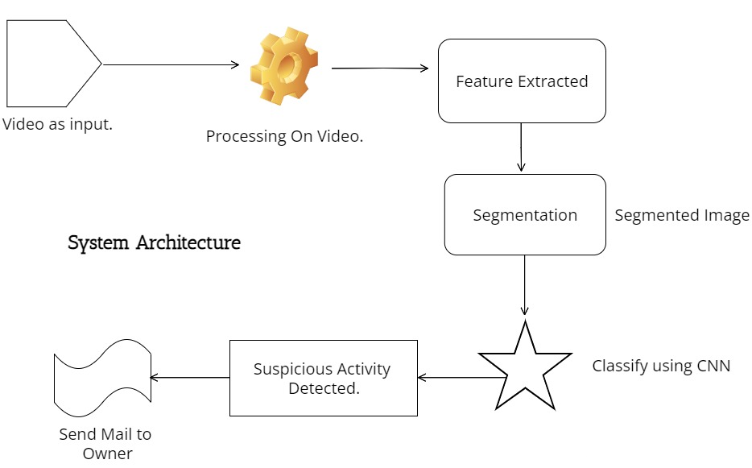
System Architecture

Slide 10
Methodology
CNN Convolutional Neural Network. he field of computer vision and image analysis which is the Convolutional Neural Networks (CNN) .
Their applications range from image and video recognition, image classification,image analysis, computer vision and natural language processing.

Slide 11
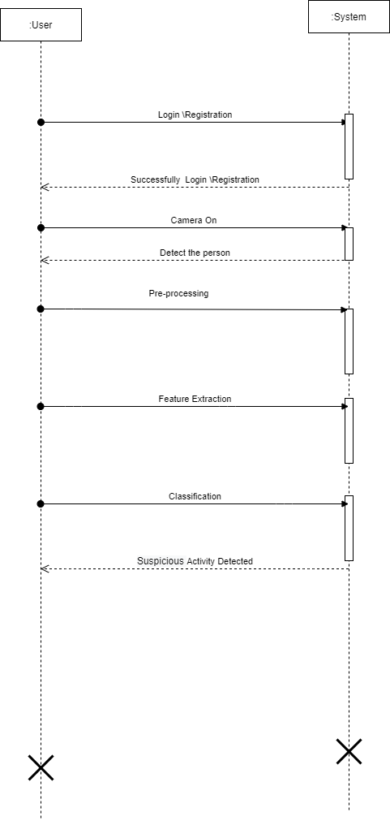
UML Digram

Slide 12
Projects Requirement
Hardware Requirement:
RAM : 8 GB
Hard Disk : 40 GB
Processor : Intel i5 Processor
Software Requirement:
IDE : Spyder
Coding Language : Python Version 3.8
Operating System : Windows 10

Slide 13
Applications
Used in Surveillance at places like Malls , Railway Stations , And Airport.
Risk of Robbery or Shooting Attack
Shoplifting ,fighting.

Slide 14
_{Conclusion}
A system to process real-time CCTV footage to detect any Suspicious activity will help to create better security and less human intervention. Great strides have been made in the field of human Suspicious Activity, which enables us to better serve the myriad applications that are possible with it. Moreover, research in related fields such as Activity Tracking can greatly enhance its productive utilization in several fields.

Slide 15
References
Eralda Nishani, Betim Cico : “Computer Vision Approaches based on DeepLearning and Neural Networks” Deep Neural Networks for Video Analysisof Human Pose Estimation- 2017 6th MEDITERRANEAN CONFERENCEON EMBEDDED COMPUTING (MECO), 11-15 JUNE 2017, BAR, MONTENEGRO
Naimat Ullah Khan , Wanggen Wan : “A Review of Human Pose Estimation from Single Image”- 978-1-5386-5195-7/18/ 2018 IEEE
Qiuhui Chen, Chongyang Zhang, Weiwei Liu, and Dan Wang, ”Surveillance Human Pose Dataset And Performance Evaluation For Coarse-Grained Pose Estimation”, Athens 2018.
Baole Ai, Yu Zhou, Yao Yu : “Human Pose Estimation using Deep Structure Guided Learning”-978-1-5090-4822-9/17 2017 IEEE DOI 10.1109/WACV.2017.141
Zhe Cao, Tomas Simon, Shih-En Wei, Yaser Sheikh The Robotics Institute, Carnegie Mellon University ”Real time Multiperson 2D Pose Estimation using part affinity fields” - 1063-6919/17 2017 IEEE DOI 10.1109/CVPR.2017.143
Hanguen Kim, Sangwon Lee, Dongsung Lee, Soonmin Choi, JinsunJu and Huyun Myung “Real-Time Human Pose Estimation and Gesture Recognition from depth Images Using Superpixels and SVM classifier.”- Sensors 2015, 15, 12410-12427; doi:10.3390/s150612410

Slide 16
In paper [1] Real-Time suspecious Detection and Localization in Crowded Scenes. [Mohammad Sabokrou , Mahmood Fathy]
In paper [2] Learning Temporal Regularity in Video Sequences. [Mahmudul Hasan Jonghyun Choi]
In paper [3] suspecious Detection in Video Using Predictive Convolutional Long Short-Term Memory Networks [Jefferson Ryan Medel]
In paper [4] Abnormal Event Detection in Videos using Spatiotemporal Auto encoder. [Yong Shean Chong]
In paper [5] Unrolled Optimization with Deep Priors. [Steven Diamond Vincent Sitzmann]
In paper [6] A Revisit of Sparse Coding Based suspecious Detection in Stacked RNN Framework.[Weixin Luo]
In Paper [7] Connections Between Nuclear-Norm and FrobeniusNorm-Based Representations. [Xi Peng, Canyi Lu, Zhang Y]
In Paper [8], A Review of Human suspecious activity from Single Image [Naimat Ullah Khan, Wanggen Wan]
In Paper [9], Human Pose Estimation using Deep Structure Guided Learning [Baole Ai, Yu Zhou, Yao Yu, Sidan Du Nanjing]

